Slide 1

1
MINI
PROJECT

Slide 2


2
MAHATMA GANDHI CENTRAL UNIVERSITY , BIHAR
Decoding 25-Year Temperature Trends: Deep Learning Insights from Mahatma Gandhi Central University Time Series Data
Presented By:
MGCU2020CSIT3006
Arti Choudhary
Mukul Anand
MGCU2020CSIT3014
Raunak Kumar
MGCU2020CSIT3020

Slide 3




Our Mentor:
3
Mr. Harshit Srivastava sir
Our Team:
Arti Choudhary
Raunak Kumar
Mukul Anand
MGCU2020CSIT3006
MGCU2020CSIT3014
MGCU2020CSIT3020

Slide 4
4
TABLE OF CONTENTS
1. Introduction
2. Background of Project
3. Problem Definition
4. Mission and Vision
5. Dataset
6. Hardware and Software Requirement
7. Flowchart
8. Dataset Discription
9. Preprocessing
10. Dataset Plotting
11. Trend, Seasonality, Residual
11. Applying Statistical Model
12. Applying DL Model
13. Comparison of model
14. Forecasted Results & Plotting
15. Refrences

Slide 5
Introduction
5
Deep Learning
Deep learning is a method in artificial intelligence (AI) that teaches computers to process data in a way that is inspired by the human brain. Deep learning models can recognize complex patterns in pictures, text, sounds, and other data to produce accurate insights and predictions
Time Series Data
Time series data, also referred to as time-stamped data, is a sequence of data points indexed in time order. These data points typically consist of successive measurements made from the same source over a fixed time interval and are used to track change over time.

Slide 6
6
Background of Project
In this study, we explore 25 years of temperature data from Mahatma Gandhi Central University (MGCU) using deep learning methods. Uncovering intricate trends, our analysis reveals nuanced fluctuations and long-term patterns in temperature. By leveraging machine learning, we extract valuable insights that illuminate the dynamic nature of these changes.
Through careful examination and model training, we decode the underlying implications with in these temperature trends. Our work not only unveils climatic evolution but also showcases the power of deep learning in understanding complex temporal data.
As we decipher the past, we glimpse into the future, envisioning applications in climate science and urban planning. This effort underscores the importance of merging advanced computational techniques with environmental data to derive meaningful and actionable knowledge.

Slide 7
7
Problem Definition
This study explores 25 years of temperature data from Mahatma Gandhi Central University (MGCU) using deep learning techniques. Revealing hidden temperature trends, the analysis uncovers nuanced fluctuations and long-term patterns. By leveraging machine learning, we extract insightful patterns that illuminate the dynamic nature of temperature changes.
Through detailed examination and model training, we uncover the underlying insights within these temperature trends. Our work not only offers insights into climatic evolution but also demonstrates the potential of deep learning in deciphering complex temporal data.
As we decipher the past, we also glimpse into the future, envisioning applications across fields like climate science and urban planning. This effort highlights the importance of blending advanced computational techniques with environmental data to extract meaningful and actionable knowledge.

Slide 8
8
Mission & Vision
Mission :
Our project's mission is to employ deep learning techniques to analyze 25 years of temperature data from MGCUB. By uncovering hidden patterns and trends, we aim to enhance climate understanding, provide predictive insights, and support informed decision-making for sustainable practices and climate resilience.
Vision :
Our vision is to harness the potential of deep learning to extract valuable insights from long-term temperature data. Through accurate predictions and actionable findings, we aspire to contribute to adaptive solutions, raise public awareness, foster collaboration, and lay the groundwork for ongoing advancements at the intersection of climate science and artificial intelligence.

Slide 9
9
Dataset :
Datasets :
Temperature Data of MGCUB of last 25 years
https://drive.google.com/file/d/1NKoygABRLL_oa-SrBQJmzMcwj4ueXf1v/view?usp=drive_link

Slide 10
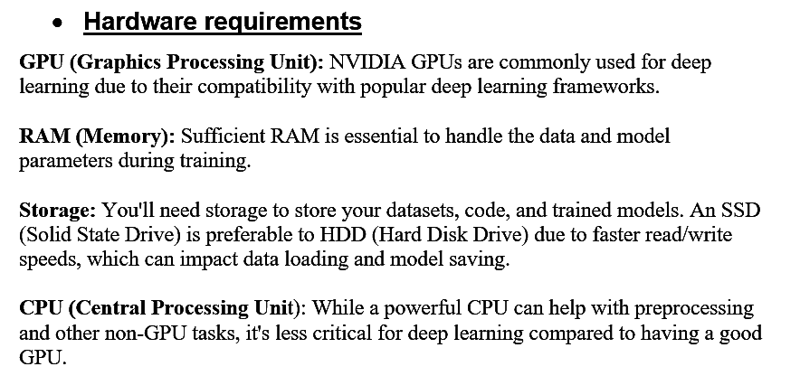
10
H/w and S/w requirements for the project

Slide 11
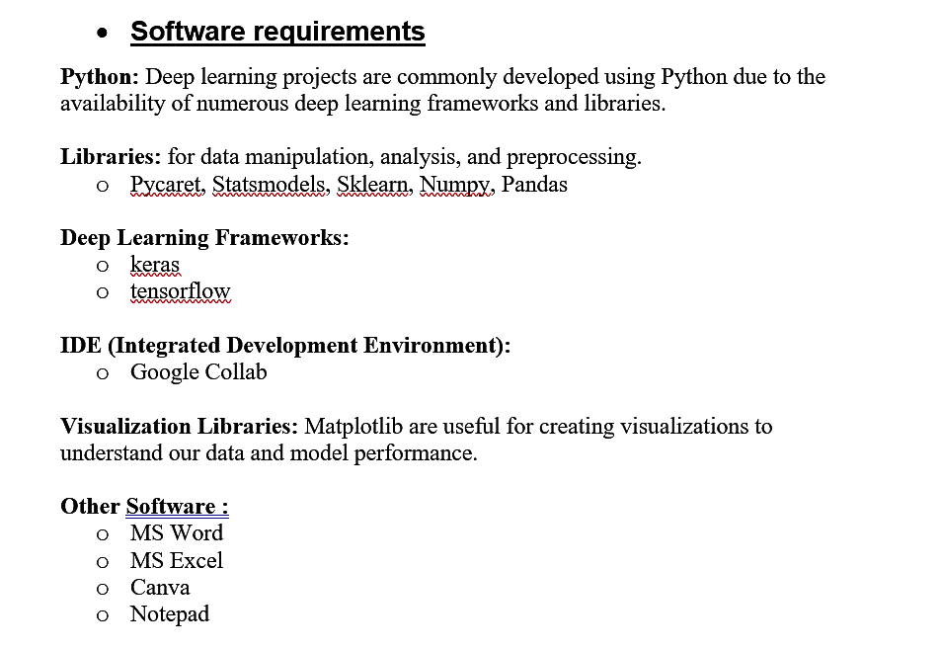
11
H/w and S/w requirements for the project

Slide 12
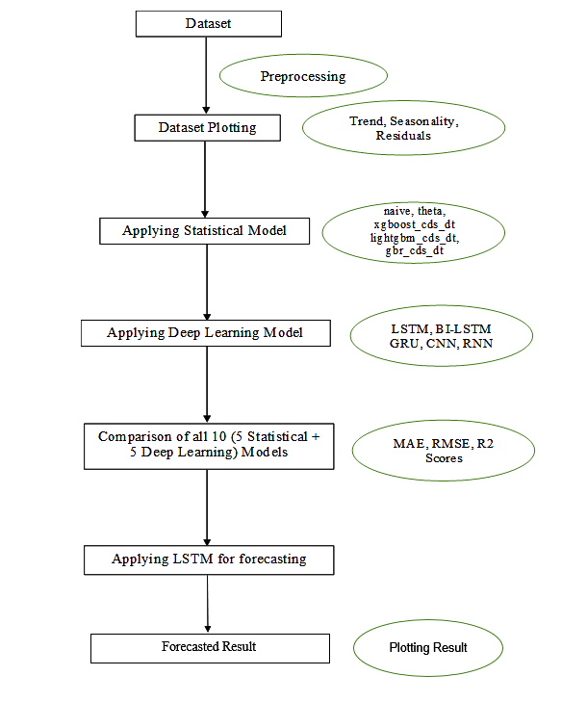
12
Flow Chart

Slide 13
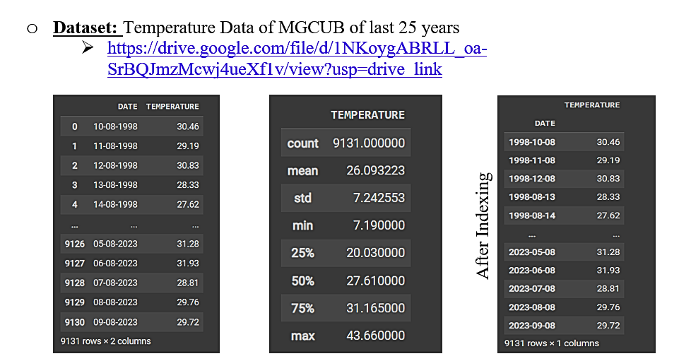
13
Dataset Description:

Slide 14
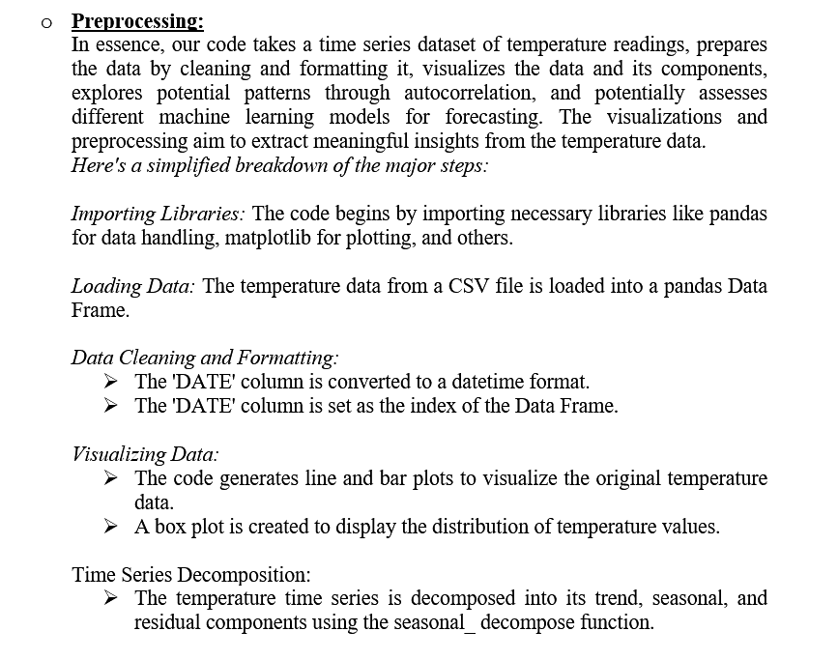
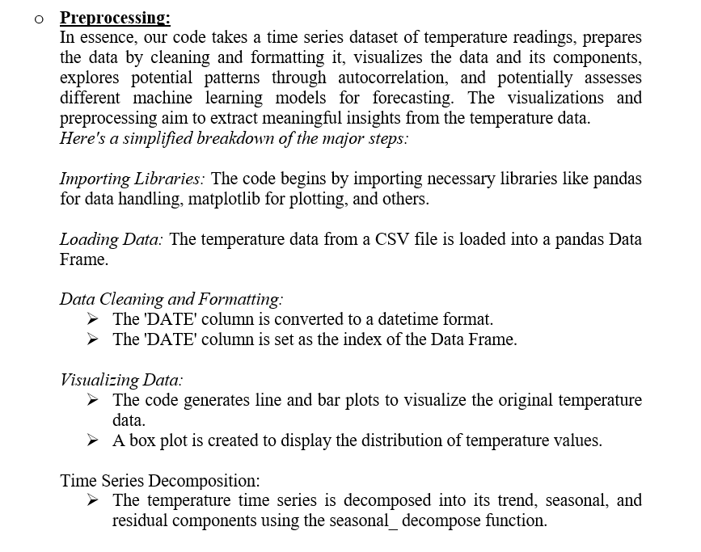
14

Slide 15
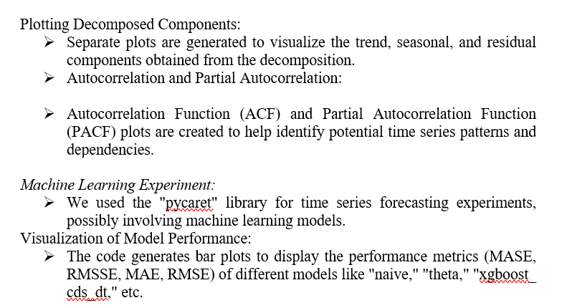
15

Slide 16
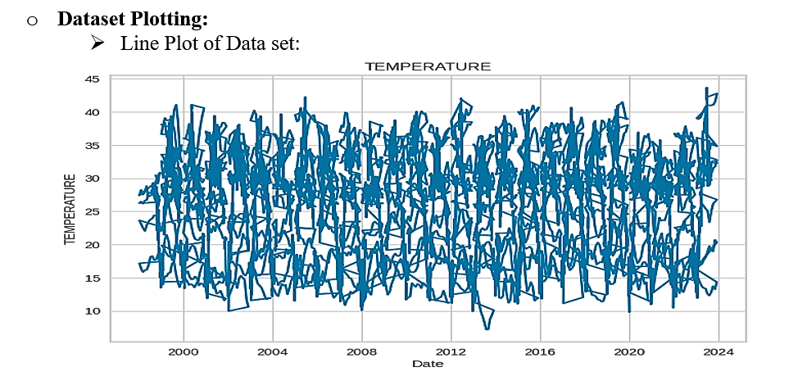
16

Slide 17
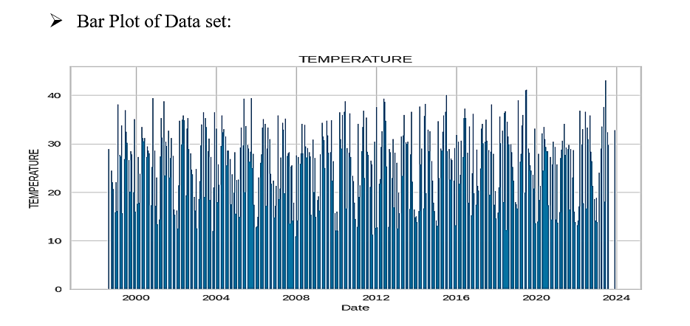
17

Slide 18
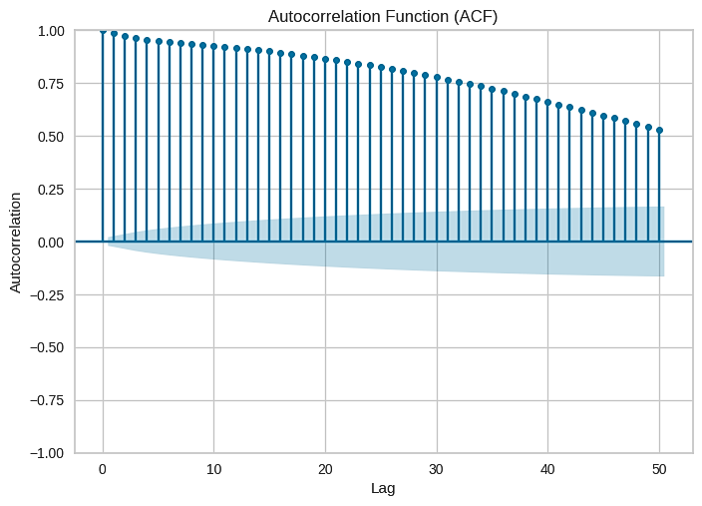
18
The autocorrelation function (ACF) reveals how the correlation between any two values of the signal changes as their separation changes. It is a time domain measure of the stochastic process memory, and does not reveal any information about the frequency content of the process.

Slide 19
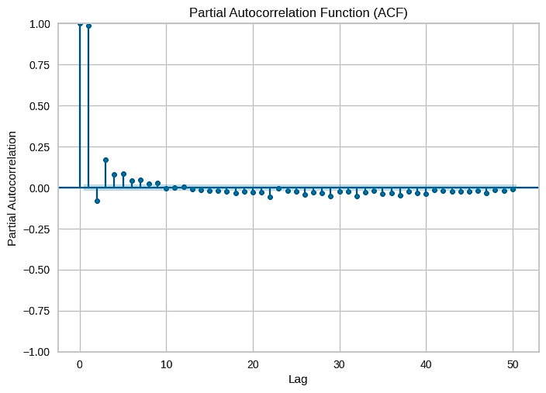
19
PACF (Partial Autocorrelation function) a single significant spike. It is measure of of relationship with other terms being accounted form (intervening lags) It can help us in understanding where our model fits in similart to that of ACF.

Slide 20
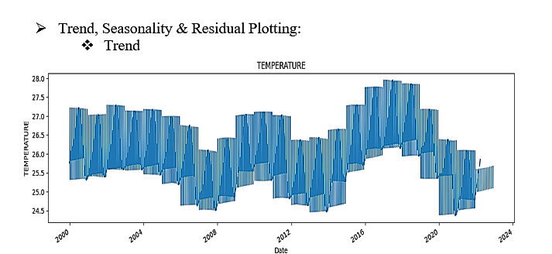
20
Long-term increase or decrease in the data. The trend can be any function, such as linear or exponential, and can change direction over time.

Slide 21
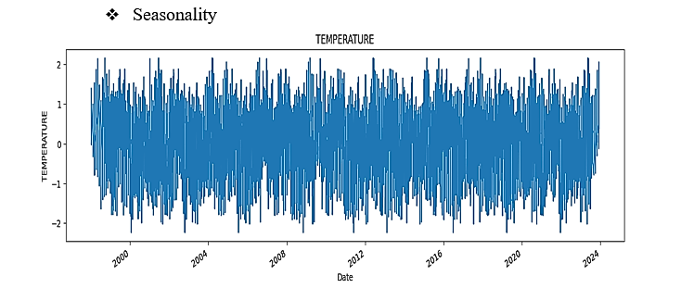
21
Seasonality is a variation that occurs at specific regular intervals of less than a year. Seasonality can occur on different time spans such as daily, weekly, monthly, or yearly. Finally, cyclic variations are rises and falls that are not of a fixed frequency. An important characteristic of time-series is stationarity.

Slide 22
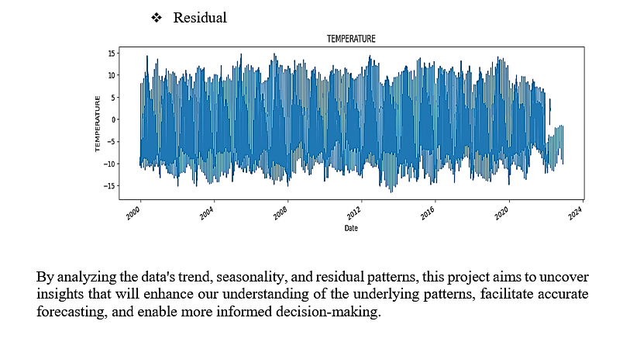
22
Residuals in a statistical or machine learning model are the differences between observed and predicted values of data. They are a diagnostic measure used when assessing the quality of a model. They are also known as errors.

Slide 23
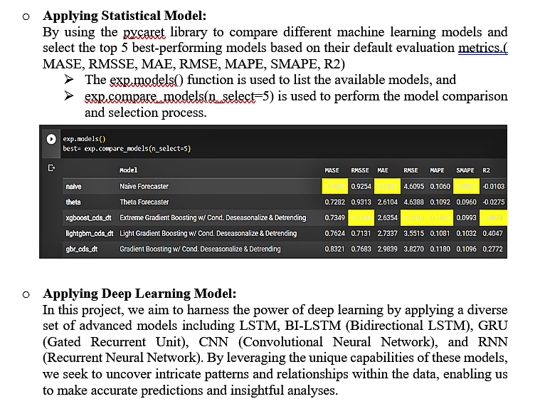
23

Slide 24
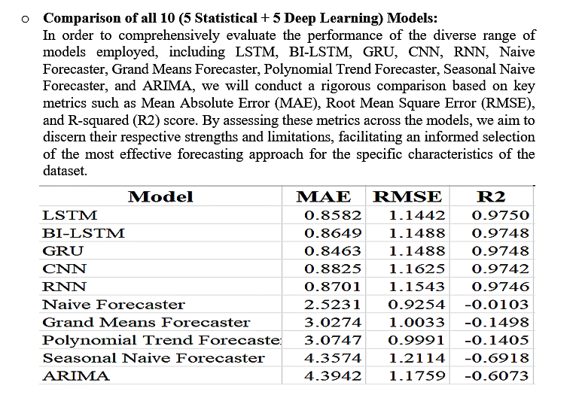
24

Slide 25
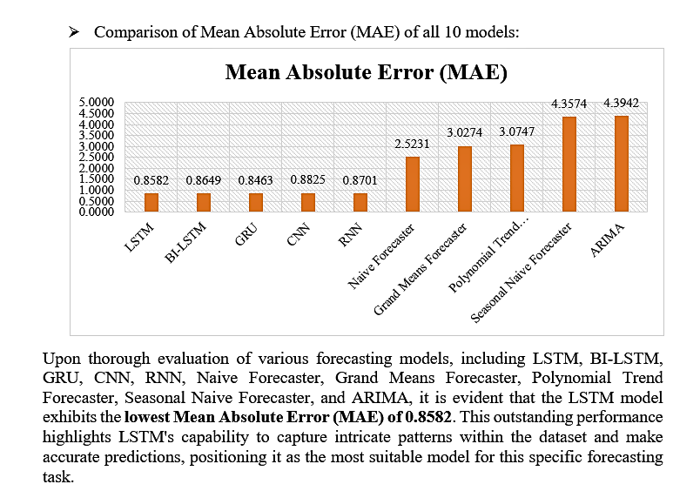
25

Slide 26
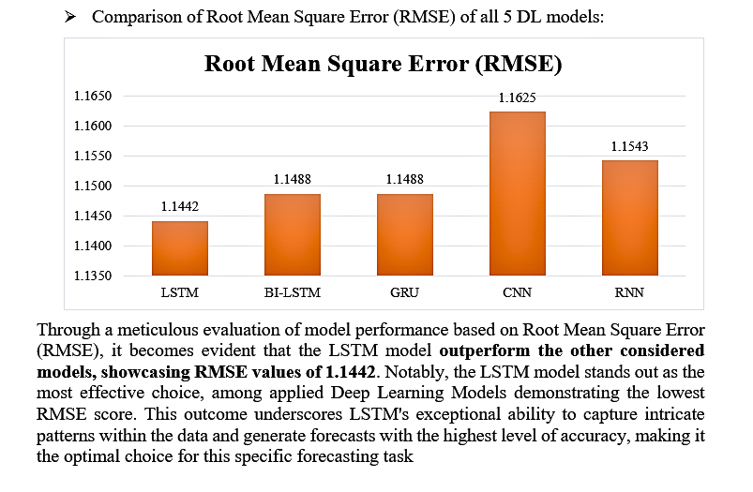
26

Slide 27
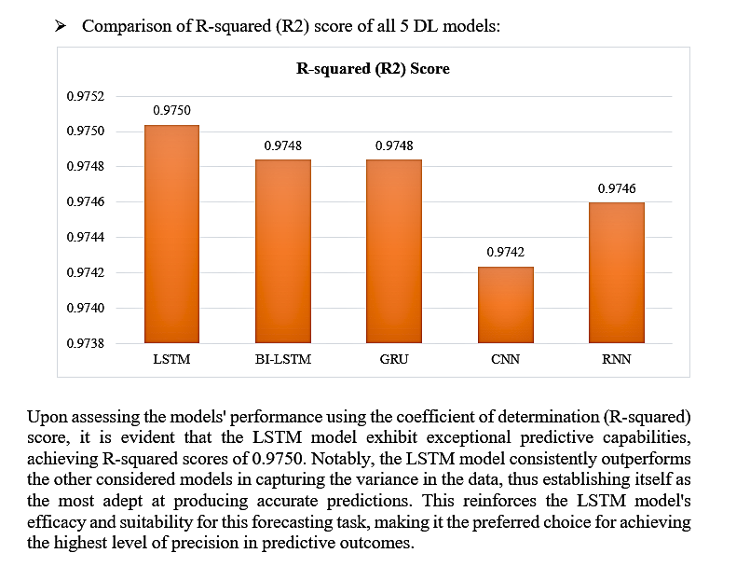
27

Slide 28
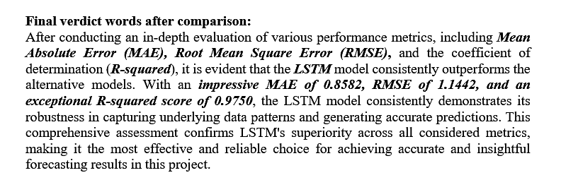
28

Slide 29
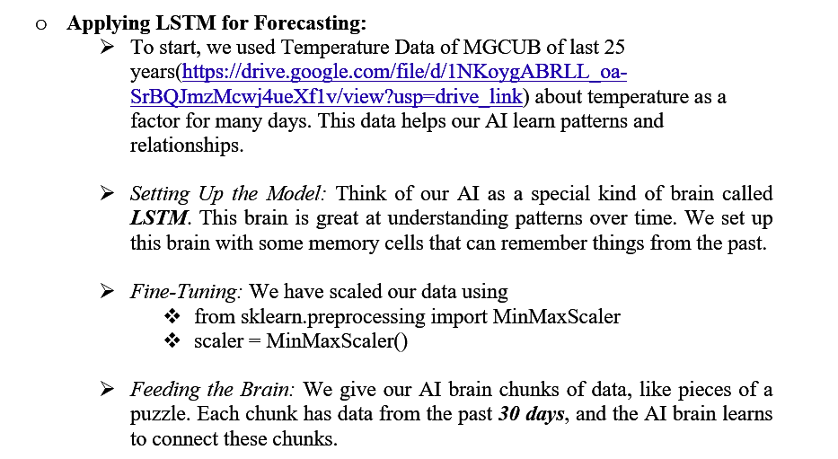
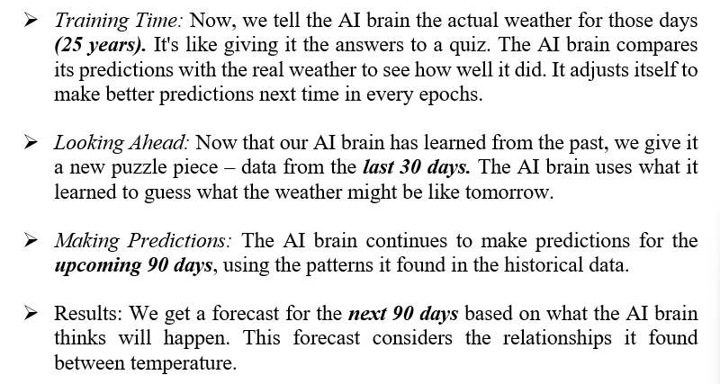
29

Slide 30

30

Slide 31
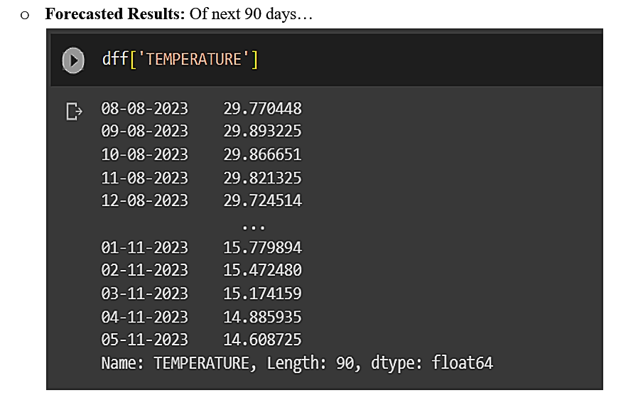
31

Slide 32
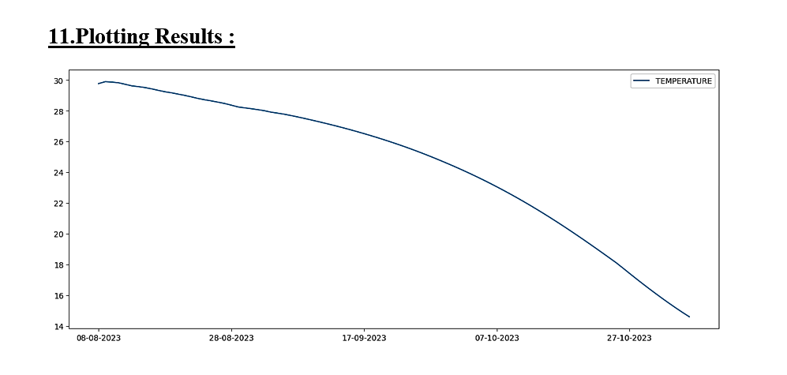
32

Slide 33
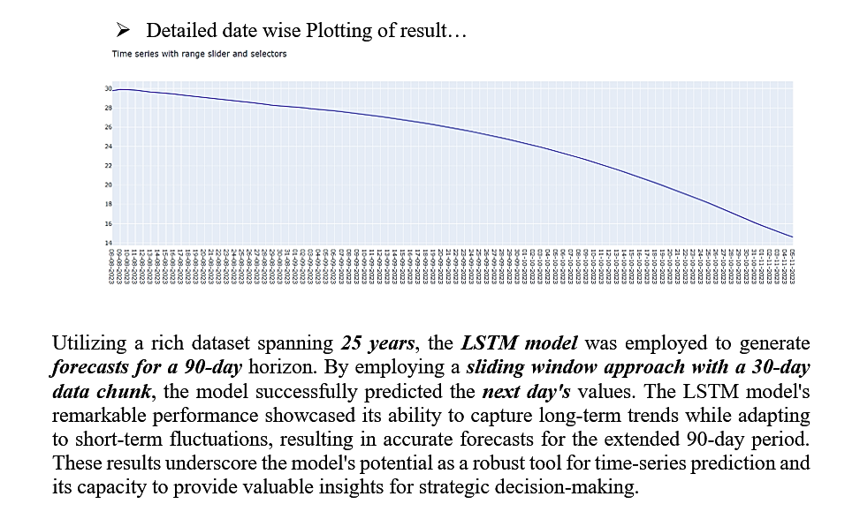
33

Slide 34
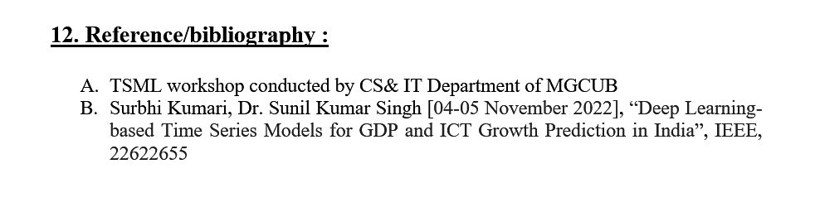
34

Slide 35

35

